Slide 1
Mathematics for Machine Learning (ML) Vectors and Matrices
Artificial Intelligence
School of Cyber Security & Digital Forensics
M. Sc. Cyber Security (Semester-I)

Slide 2

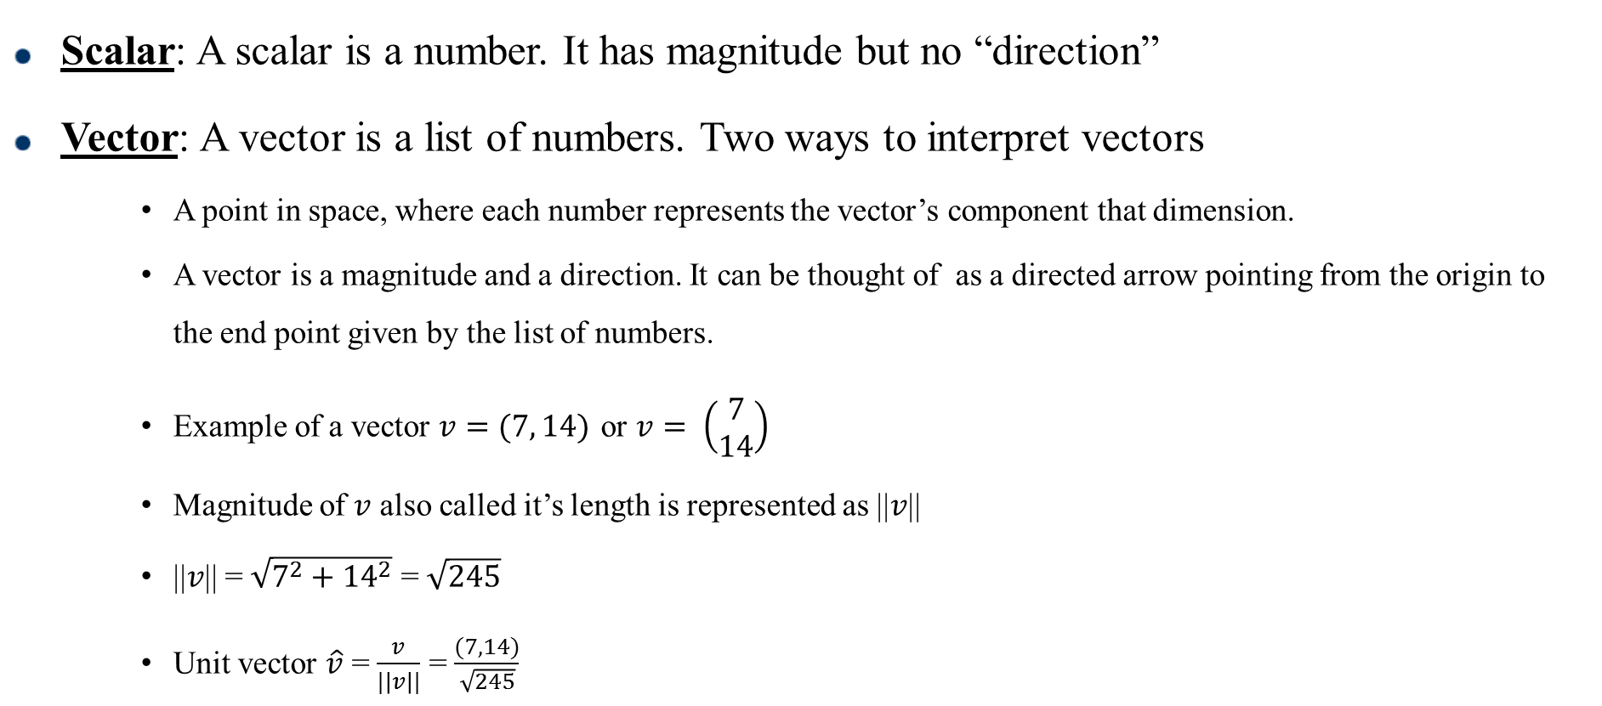


Scalars and Vectors
Scalar: A scalar is a number. It has magnitude but no “direction”
Vector: A vector is a list of numbers. Two ways to interpret vectors
A point in space, where each number represents the vector’s component that dimension.
A vector is a magnitude and a direction. It can be thought of as a directed arrow pointing from the origin to the end point given by the list of numbers.
Example of a vector $v=(7, 14)$ or $v= \left(\begin{matrix}7 \\ 14\end{matrix}\right)$
Magnitude of $v$ also called it’s length is represented as ||$v$||
||$v$|| = $\sqrt{7^{2}+{14}^{2}}$ =$\sqrt{245}$
Unit vector $\hat{v}$ = $\frac{v}{|\left|v\right||}$ = $\frac{(7, 14)}{\sqrt{245}}$
$$v$$
$$14$$
$$7$$
Fig 1. Graphical representation of vector $v$

Slide 3
Vector Arithmetic
Vector Addition: It is performed element-wise between two vectors of equal length to result in a new vector with the same length.
Example: c = a + b = (a1 + b1, a2 + b2, a3 + b3)
Vector Subtraction: Similar to addition, each element of the resultant vector is calculated as the subtraction of the elements at the same indices and has the same length as the parent vectors.
Example: c = a - b = (a1 - b1, a2 - b2, a3 - b3)

Slide 4
Vector Arithmetic
Vector Multiplication: It is performed element-wise between two vectors of equal length to result in a new vector with the same length.
Example: c = a x b = (a1 x b1, a2 x b2, a3 x b3)
Vector Division: Similar to other operations, each element of the resultant vector is element-wise division of first vector by the second and has the same length as the parent vectors.
Example: c = a / b = (a1 / b1, a2 / b2, a3 / b3)

Slide 5
Vector Arithmetic
Vector Dot Product: It is the sum of the multiplied elements of two vectors of the same length to give a scalar.
Example: c = a . b = (a1 x b1 + a2 x b2 + a3 x b3)
Also a . b = ||a|| ||b||cosθ , where θ is the angle between a and b
Vector Scalar Multiplication: A vector can be multiplied by a scalar, in effect of scaling the magnitude of the vector. Example: (s is a scalar) c = s a = (s x a1 , s x a2, s x a3)

Slide 6
Linear Independence
If two vectors point in different directions, even if they are not very different directions, then the two vectors are said to be linearly independent.
If vectors a and b point in the same direction, then you can multiply vector a by a constant, scalar value and get vector , and vice versa to get from b to a . If the two vectors point in different directions, then this is not possible to make one out of the other because multiplying a vector by a scalar will never change the direction of the vector, it will only change the magnitude.

Slide 7
Linear Independence
Generalizing to families of more than two vectors; 3 vectors are said to be linearly independent if there is no way to construct one vector by combining scaled versions of the other two. The same definition applies to families of four or more vectors by applying the same rules.
Definition: A family of vectors is linearly independent if no one of the vectors can be created by any linear combination of the other vectors in the family. For example, c is linearly independent of a and b if and only if it is impossible to find scalar values of α and β such that c = α a + β b else it is linearly dependent.

Slide 8
Orthogonality and Vector Space
Orthogonal Vectors: Two vectors are said to be orthogonal if they are perpendicular to each other.
How can we determine orthogonality ????
Vector Space: The space in which vectors live. The space R^{n} consists of all column vectors v with n components. The components of v are all real numbers and hence the notation R. A vector whose n components are complex numbers lines in C^{n} space.

Slide 9
Basis Vectors
The definition of a set of basis vectors is twofold: (1) linear combinations of the basis vectors can describe any vector in the vector space, and (2) every one of the basis vectors must be required in order to be able to describe all of the vectors in the vector space.
Definition: A basis set is a linearly independent minimal set of vectors that, when used in linear combination, can represent every vector in a given vector space.
Basis for a 3-d vector space ???
Can there be multiple choices for the basis vector ?????
……. Dimension of a vector space

Slide 10
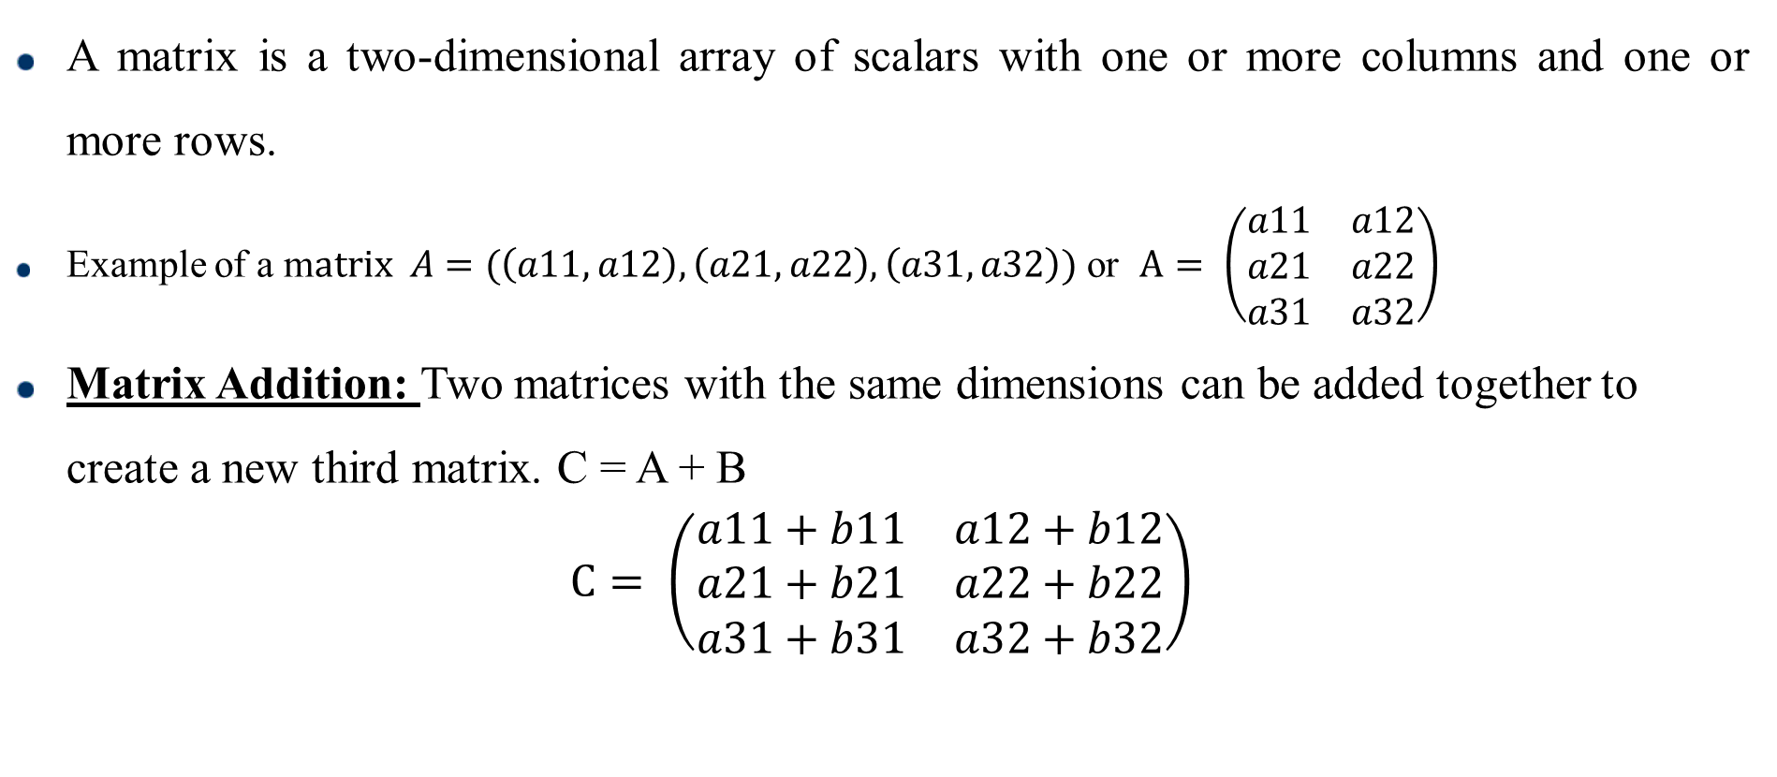
Matrices and Matrix Arithmetic
A matrix is a two-dimensional array of scalars with one or more columns and one or more rows.
Example of a m$atrix A=(\left(a11, a12\right),\left(a21, a22\right),\left(a31,a32\right))$ or $A= \left(\begin{matrix}a11 & a12 \\ a21 & a22 \\ a31 & a32\end{matrix}\right)$
Matrix Addition: Two matrices with the same dimensions can be added together to create a new third matrix. C = A + B
$$C= \left(\begin{matrix}a11+b11 & a12+b12 \\ a21+b21 & a22+b22 \\ a31+b31 & a32+b32\end{matrix}\right)$$

Slide 11
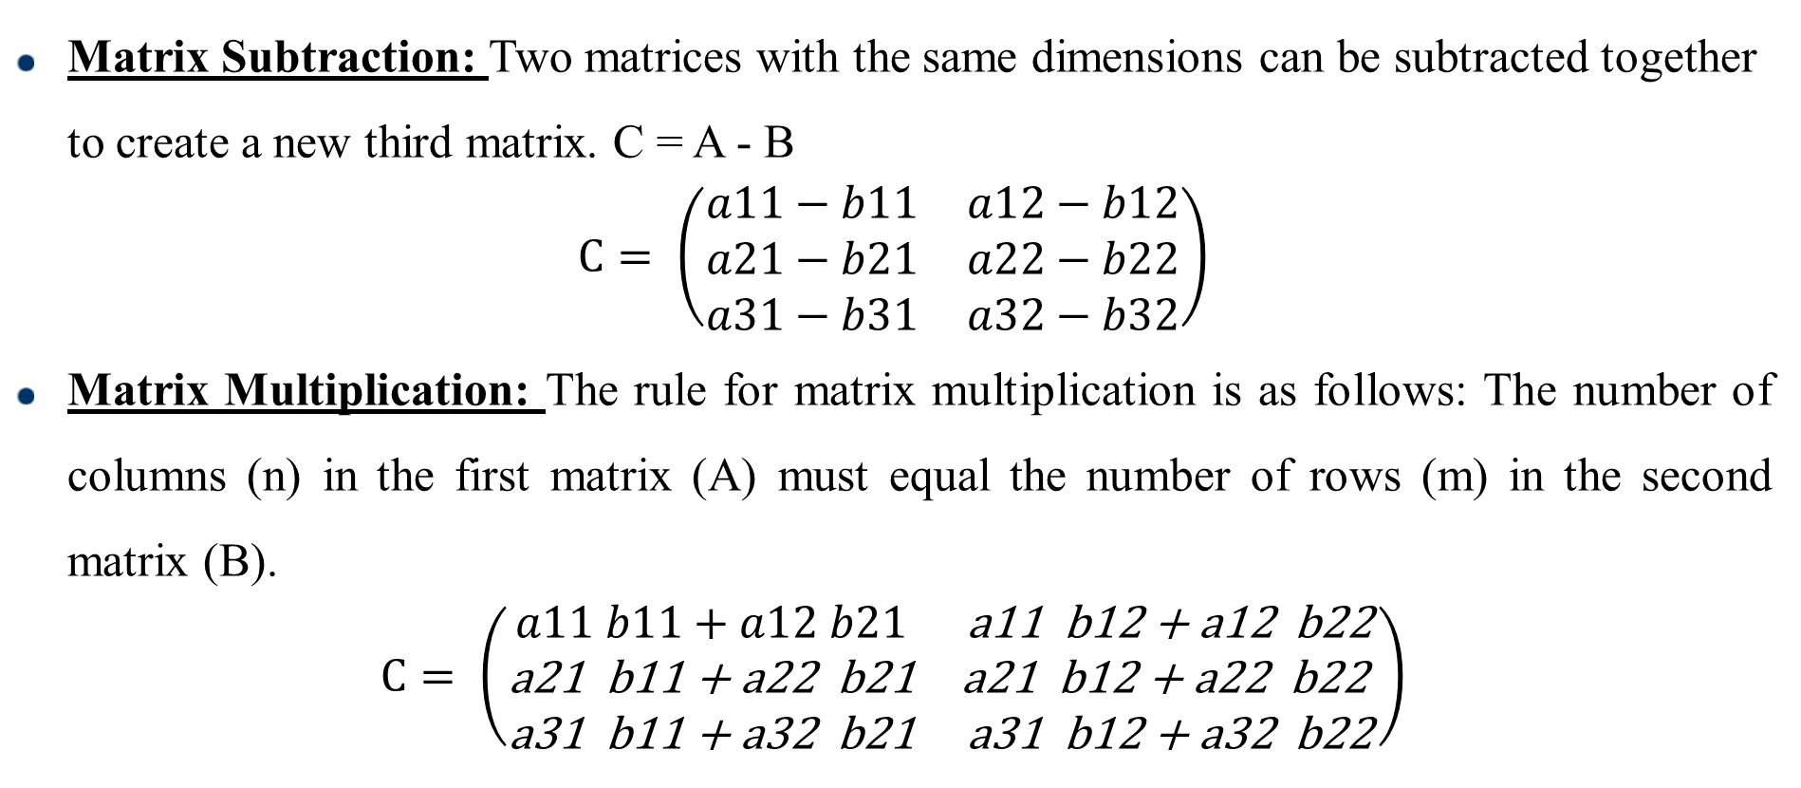
Matrices and Matrix Arithmetic
Matrix Subtraction: Two matrices with the same dimensions can be subtracted together to create a new third matrix. C = A - B
$$C= \left(\begin{matrix}a11−b11 & a12−b12 \\ a21−b21 & a22−b22 \\ a31−b31 & a32−b32\end{matrix}\right)$$
Matrix Multiplication: The rule for matrix multiplication is as follows: The number of columns (n) in the first matrix (A) must equal the number of rows (m) in the second matrix (B).
$$C= \left(\begin{matrix}a11 b11+a12 b21 & \text{a}\text{11 }\text{b}\text{12 + }\text{a}\text{12 }\text{b}\text{22} \\ \text{a}\text{21 }\text{b}\text{11 + }\text{a}\text{22 }\text{b}\text{21} & \text{a}\text{21 }\text{b}\text{12 + }\text{a}\text{22 }\text{b}\text{22 } \\ \text{a}\text{31 }\text{b}\text{11 + }\text{a}\text{32 }\text{b}\text{21} & \text{a}\text{31 }\text{b}\text{12 + }\text{a}\text{32 }\text{b}\text{22}\end{matrix}\right)$$

Slide 12
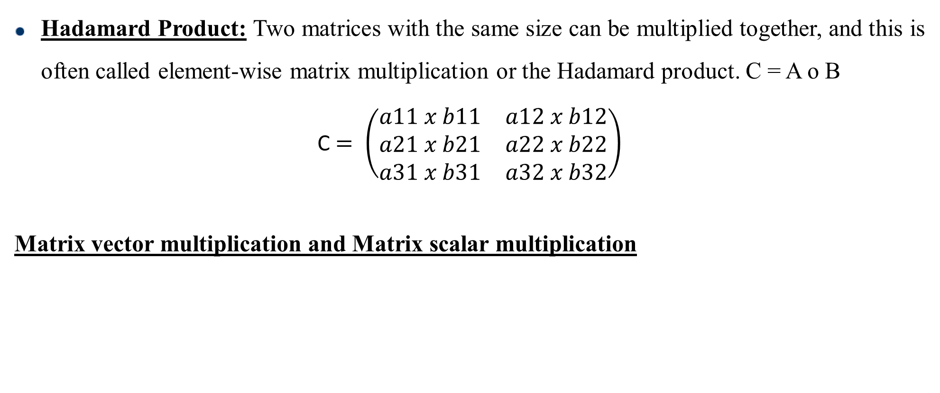
Matrices and Matrix Arithmetic
Hadamard Product: Two matrices with the same size can be multiplied together, and this is often called element-wise matrix multiplication or the Hadamard product. C = A o B
C $= \left(\begin{matrix}a11 x b11 & a12 x b12 \\ a21 x b21 & a22 x b22 \\ a31 x b31 & a32 x b32\end{matrix}\right)$
Matrix vector multiplication and Matrix scalar multiplication

Slide 13
Types of Matrices
Square Matrix: A square matrix is a matrix where the number of rows is equivalent to the number of columns
Symmetric Matrix: A symmetric matrix is always square and equal to its own transpose. M = M^{T}
Triangular Matrix : A triangular matrix is a type of square matrix that has all values in the upper-right or lower-left of the matrix with the remaining elements filled with zero values. Upper triangular matrix: triangular matrix with values only above the main diagonal
Lower triangular matrix: triangular matrix with values only below the main diagonal.

Slide 14
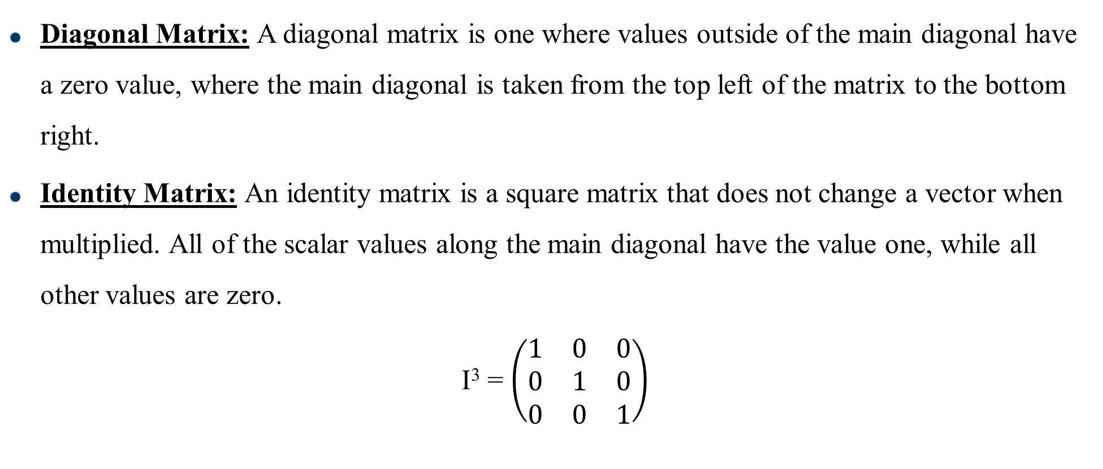
Types of Matrices
Diagonal Matrix: A diagonal matrix is one where values outside of the main diagonal have a zero value, where the main diagonal is taken from the top left of the matrix to the bottom right.
Identity Matrix: An identity matrix is a square matrix that does not change a vector when multiplied. All of the scalar values along the main diagonal have the value one, while all other values are zero.
I³ = $\left(\begin{matrix}1 & 0 & 0 \\ 0 & 1 & 0 \\ 0 & 0 & 1\end{matrix}\right)$

Slide 15
Types of Matrices
Orthonormal vector: Two vectors are orthogonal when their dot product equals zero. The length of each vector is 1 then the vectors are called orthonormal because they are both orthogonal and normalized.
Orthogonal Matrix: An orthogonal matrix is a type of square matrix whose columns and rows are orthonormal unit vectors, e.g. perpendicular and have a length or magnitude of 1.
Example of an orthogonal matrix ????
An Orthogonal matrix is often denoted as uppercase Q.
Q Q^{T} = Q^{T} Q = I Can you prove this ?

Slide 16
Mathematics for Machine Learning (ML) Solving Linear Equations(Elimination)
Artificial Intelligence
School of Cyber Security & Digital Forensics
M. Sc. Cyber Security (Semester-I)

Slide 17
Solving Linear Equations
Elimination : Elimination method produces an upper triangular matrix. The system is then solved from bottom upwards ; the process is called as back substitution.
Example :
x – 2y = 1 x – 2y = 1
3x + 2y = 11 8y = 8
Pivot: First non-zero in the row that does the elimination
Multiplier: (entry to eliminate) divided by (pivot)
To solve n equations we need n pivots

Slide 18
Solving Linear Equations
Permanent Failure with no solutions
x – 2y = 1 x – 2y = 1
3x - 6y = 11 0y = 8
Failure with infinitely many solutions
x – 2y = 1 x – 2y = 1
3x - 6y = 3 0y = 0
Temporary Failure with zero pivots
0x + 2y = 4 3x – 2y = 5
3x - 2y = 5 2y = 4

Slide 19
Solving Linear Equations
Permanent Failure with no solutions
x – 2y = 1 x – 2y = 1
3x - 6y = 11 0y = 8
Failure with infinitely many solutions
x – 2y = 1 x – 2y = 1
3x - 6y = 3 0y = 0
Temporary Failure with zero pivots
0x + 2y = 4 3x – 2y = 5
3x - 2y = 5 2y = 4

Slide 20
Solving Linear Equations
Solve the following by elimination
2x + 4y – 2z = 2
4x + 9y – 3z = 8
-2x -3y +7z = 10
========================
x + y + z = 7
x + y - z = 5
x - y + z = 3

Slide 21
References
S. No | Topics | Reference
1 | Matrices and vectors | 1) Basics of Linear Algebra for Machine Learning Discover the Mathematical Language of Data in Python by Jason Brownlee 2)Ch4_Linear_Algebra_Vectors_Matrices
2 | Basis and Linear Independence | 1) Introduction to linear algebra by Gilbert Strang
3 | Linear Equations | 1) Introduction to linear algebra by Gilbert Strang

